Slide 1
Project research
Notes: Seqmonk Analysis Tools

Slide 2
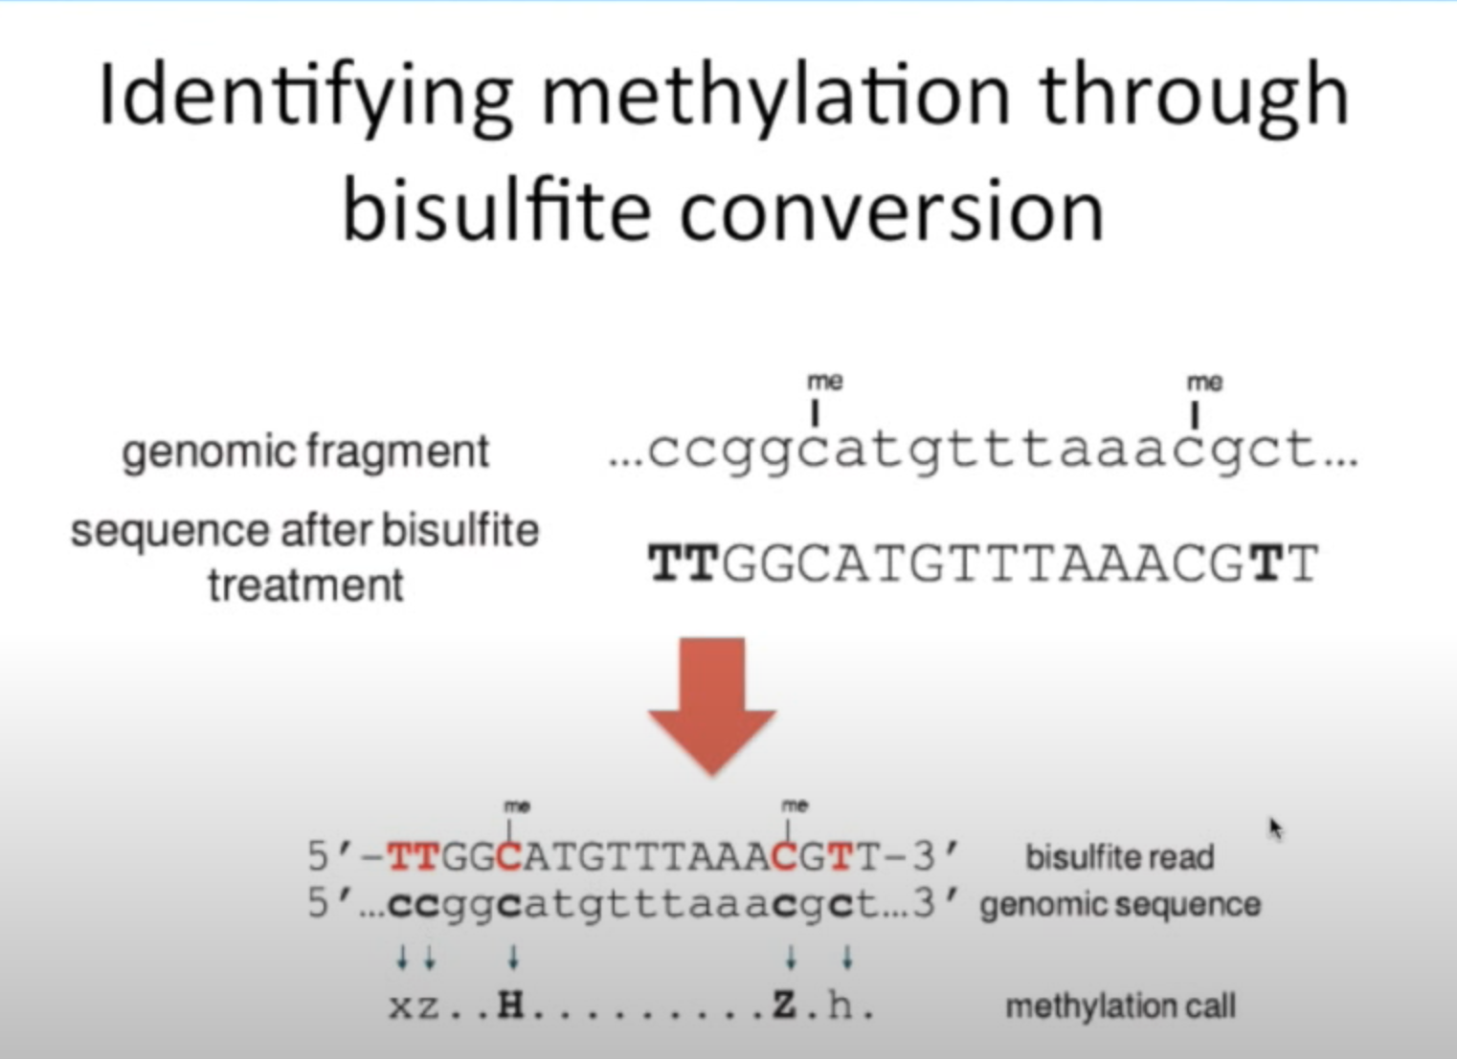
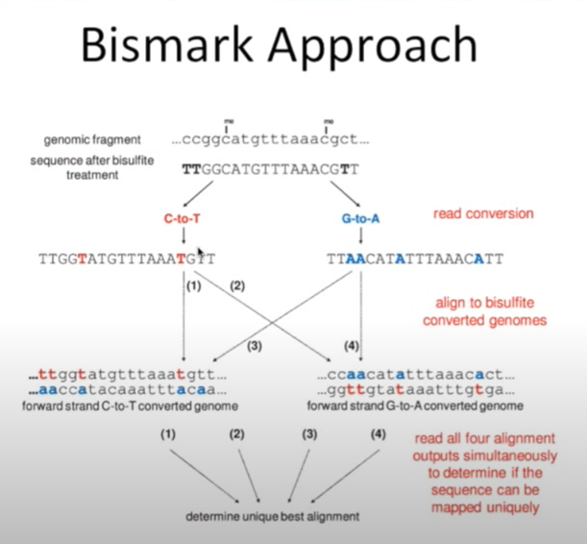
BS-Seq 1

Slide 3
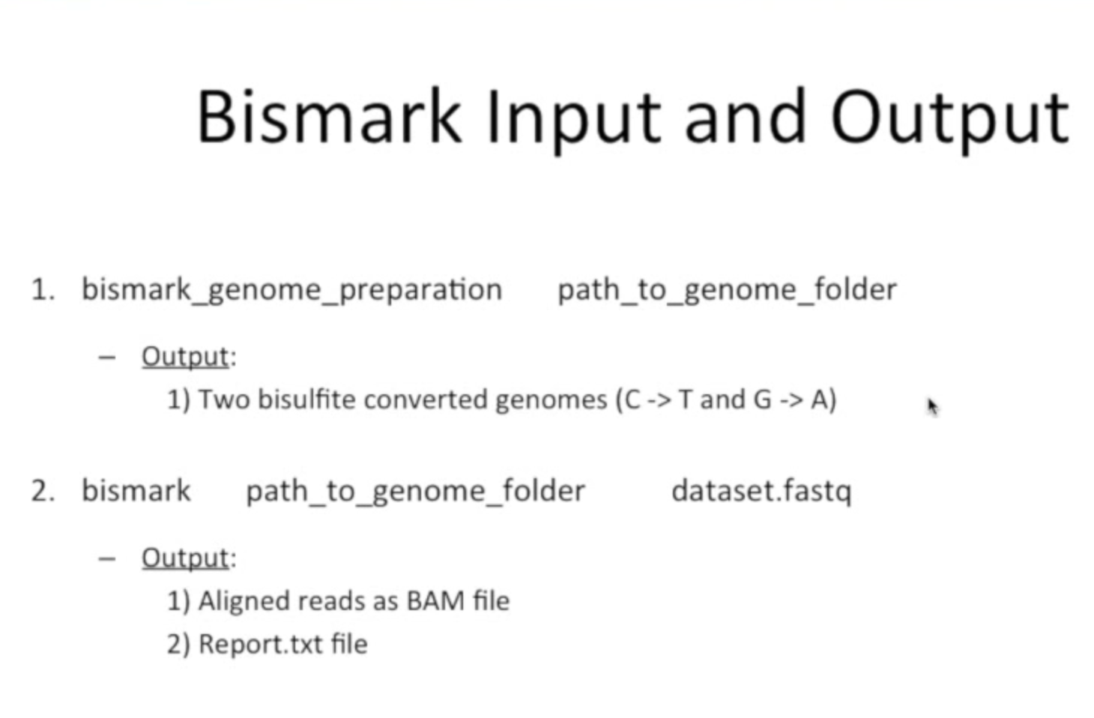
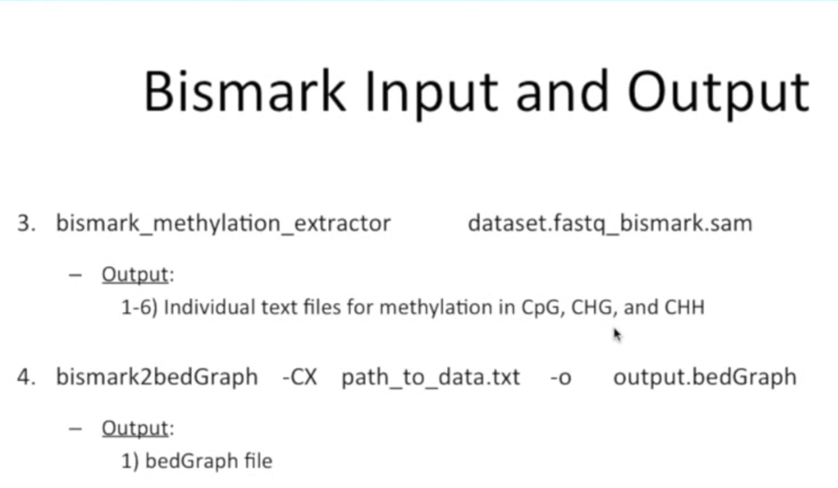
BS-Seq II

Slide 4

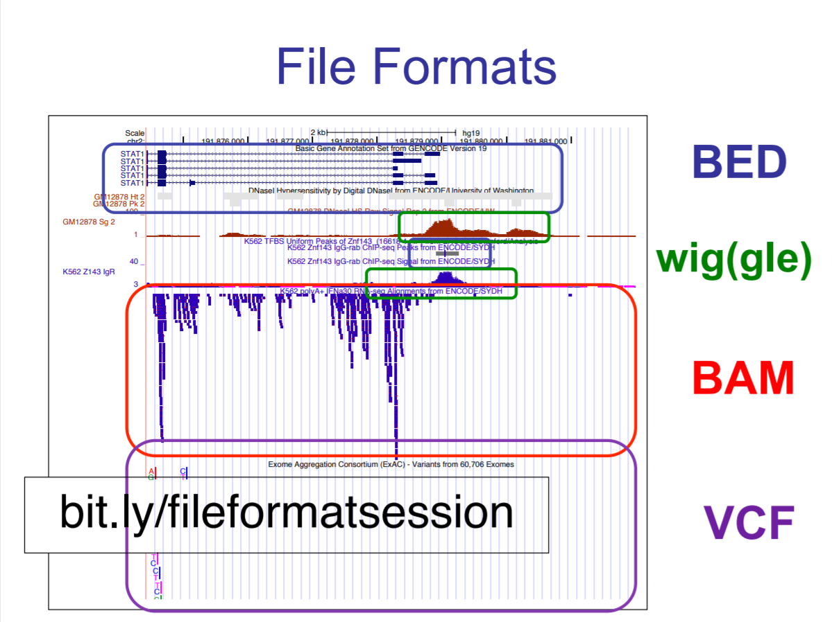
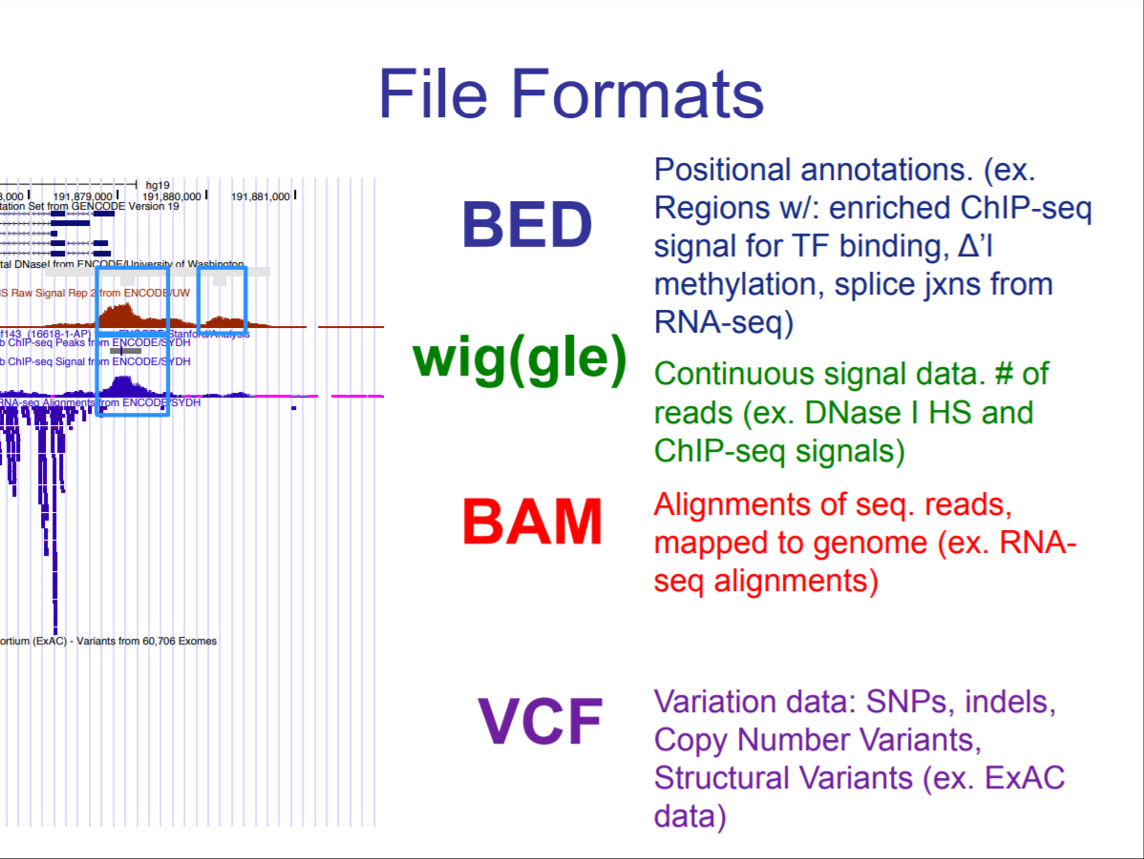
File formats

Slide 5
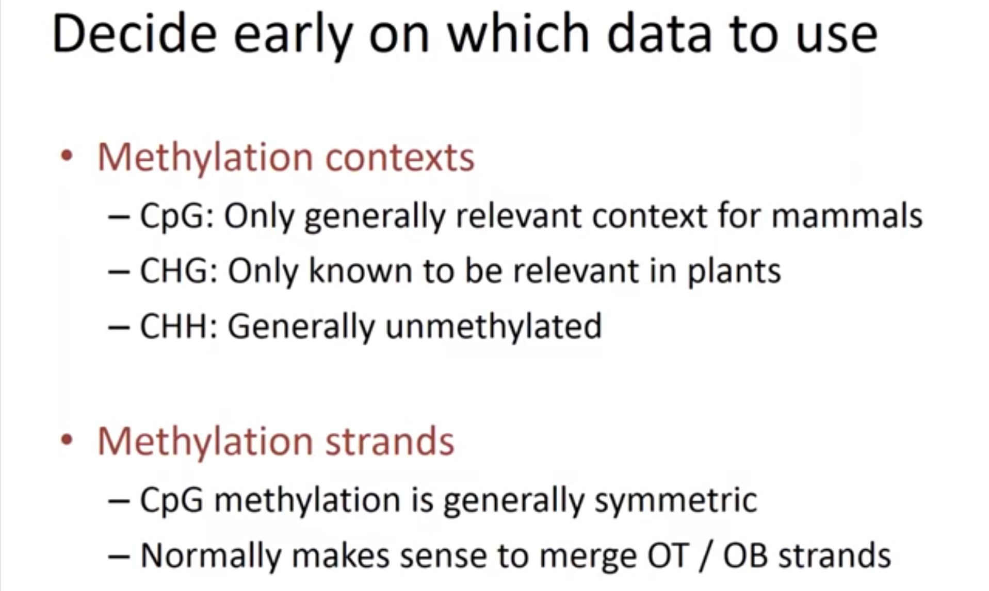
Look at all calls?
Assumption
Notes:
Propagation of Methylation – Other types of methylation washes away

Slide 6
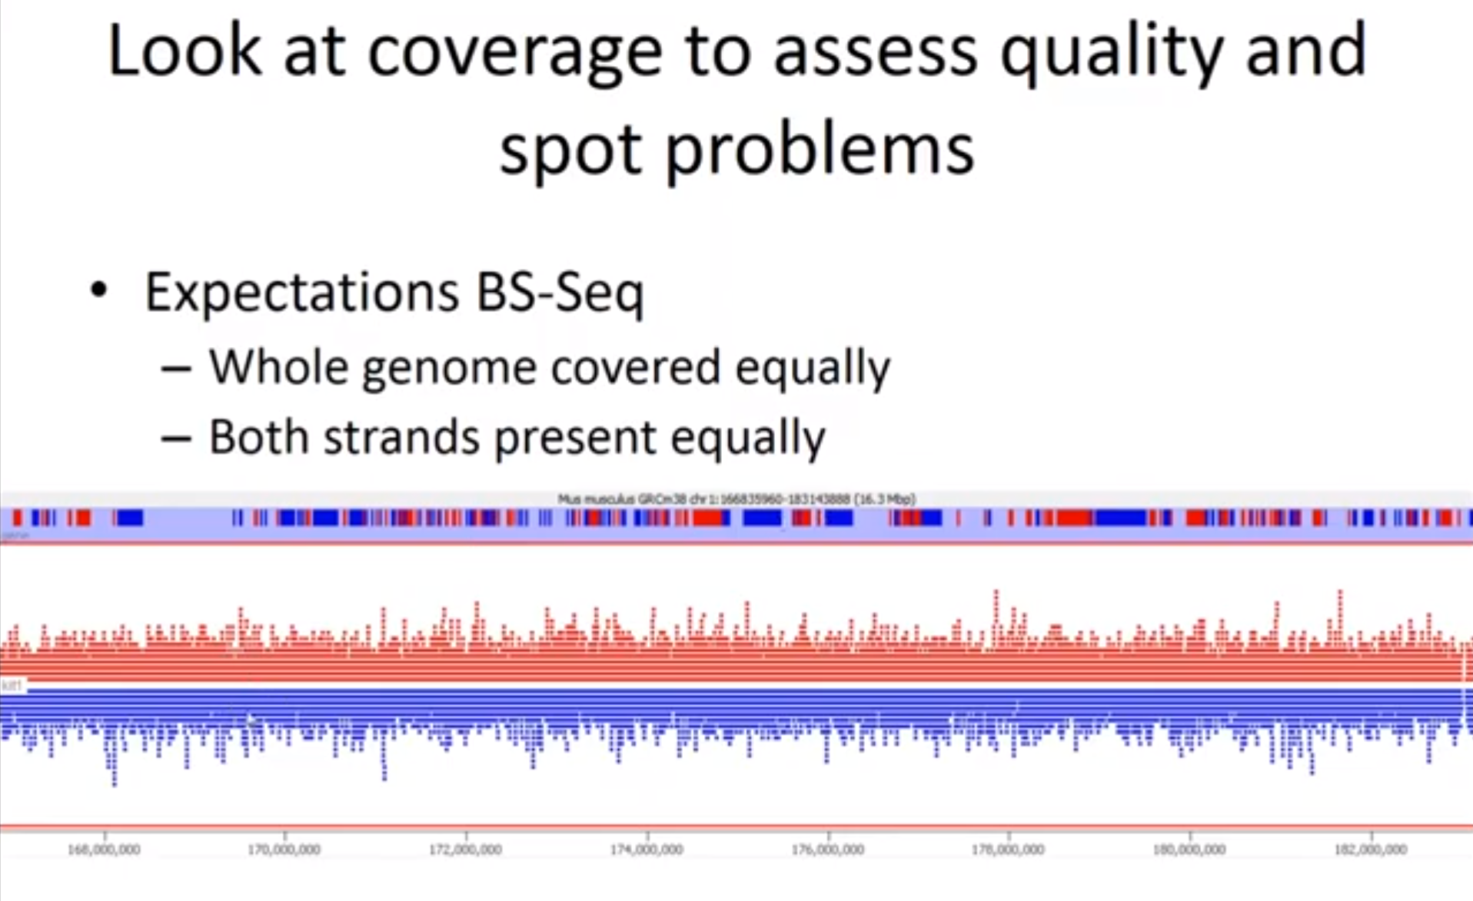
E[Reads] – Not the methylation calls
Genes

Slide 7
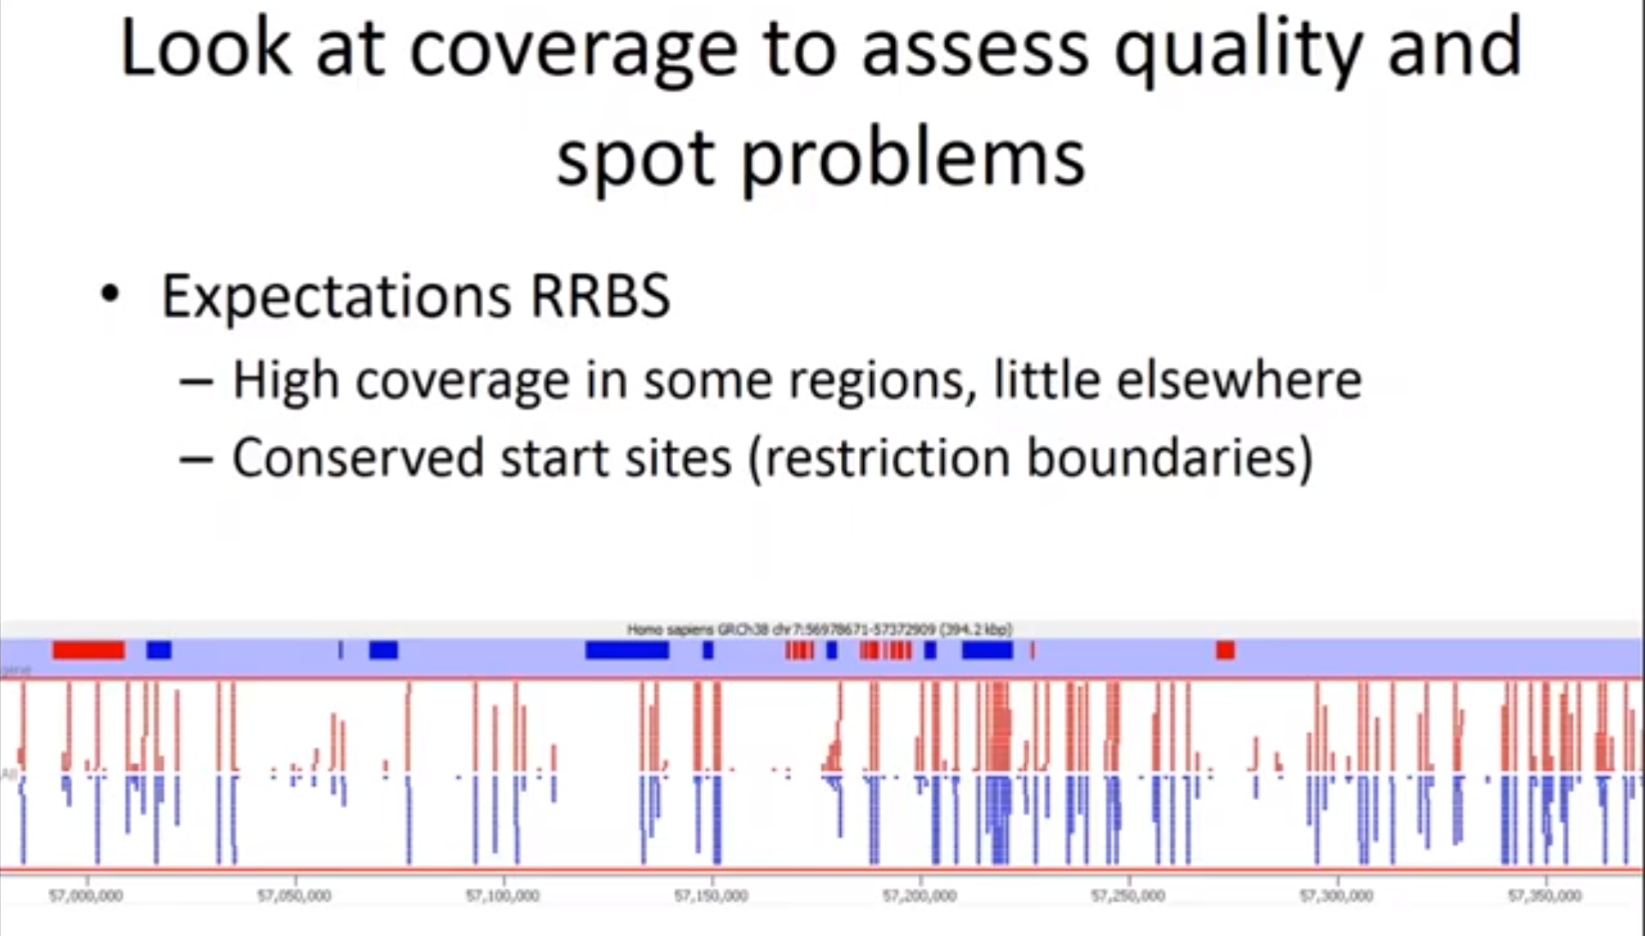
E[Reduced methyl]

Slide 8
Data analysis
Finally!!!...... ;)

Slide 9
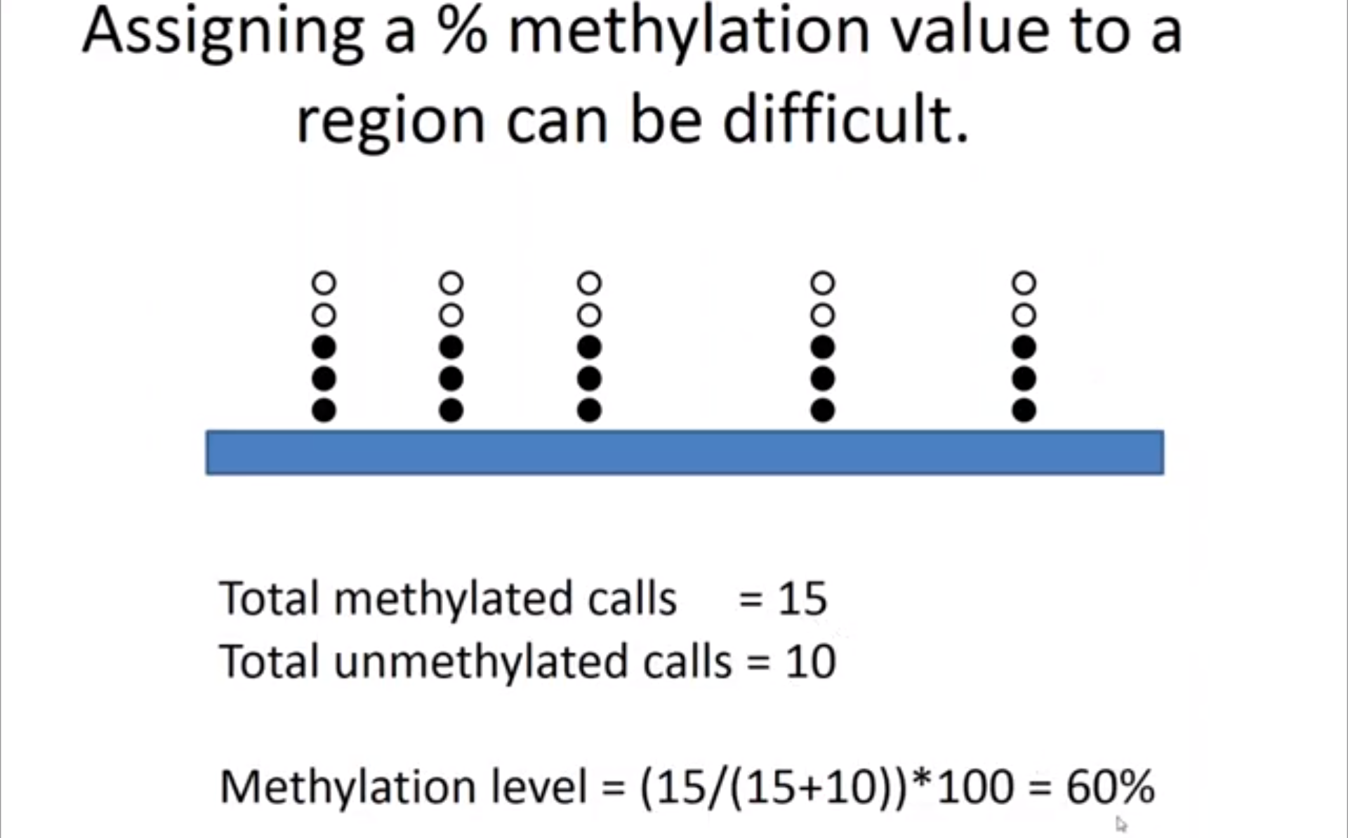
Step 1 - Quatitate
1st step to quantitate your data - %methylation
No. of methylated calls for a given region / Total No. of calls [& unmethylated]
Initially have multiple indv. Methylation calls – Collapse to a single numerical value
Ideally –

Slide 10
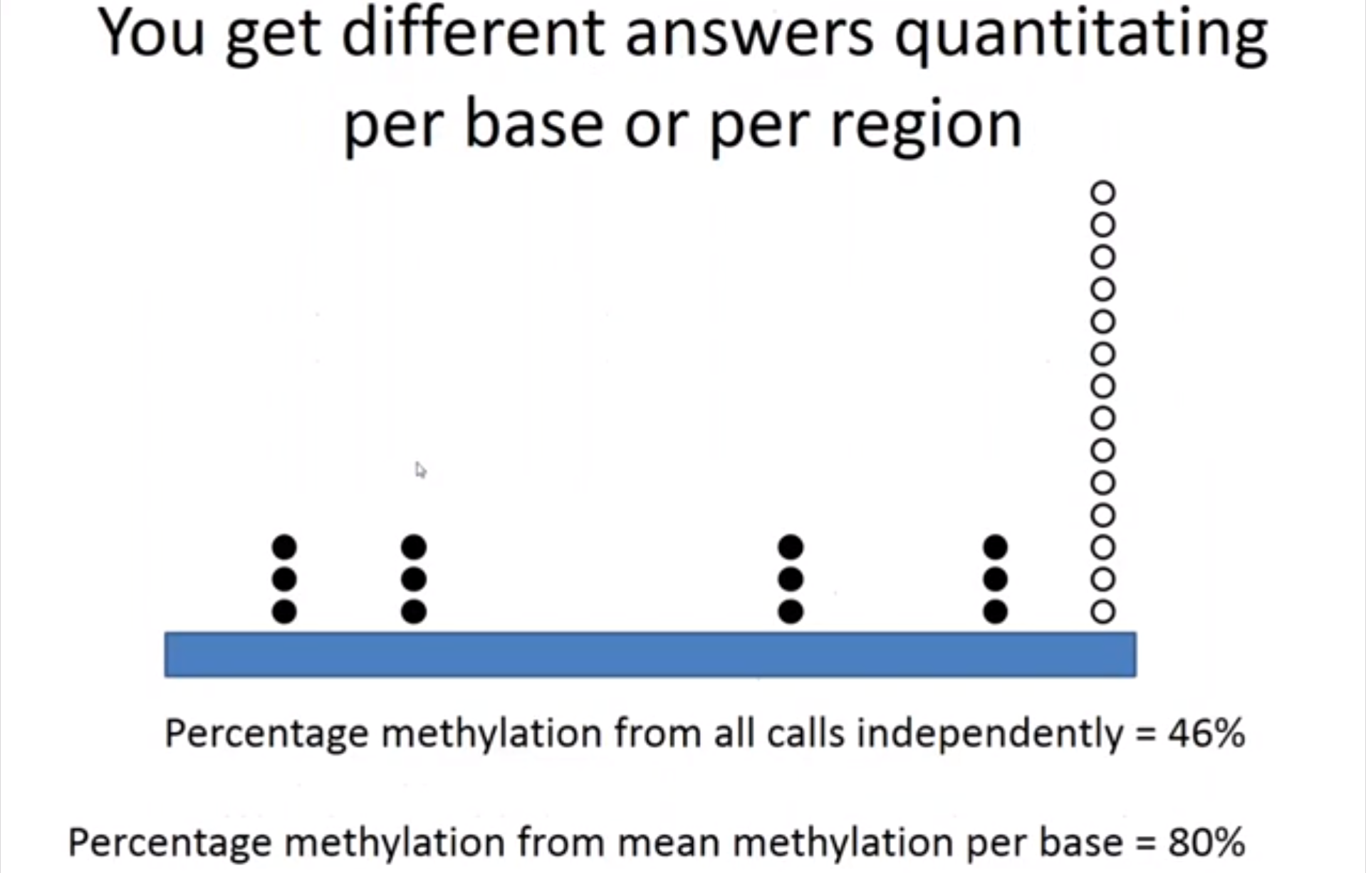
Variation in the depth of coverage across different parts of the same region
However –

Slide 11
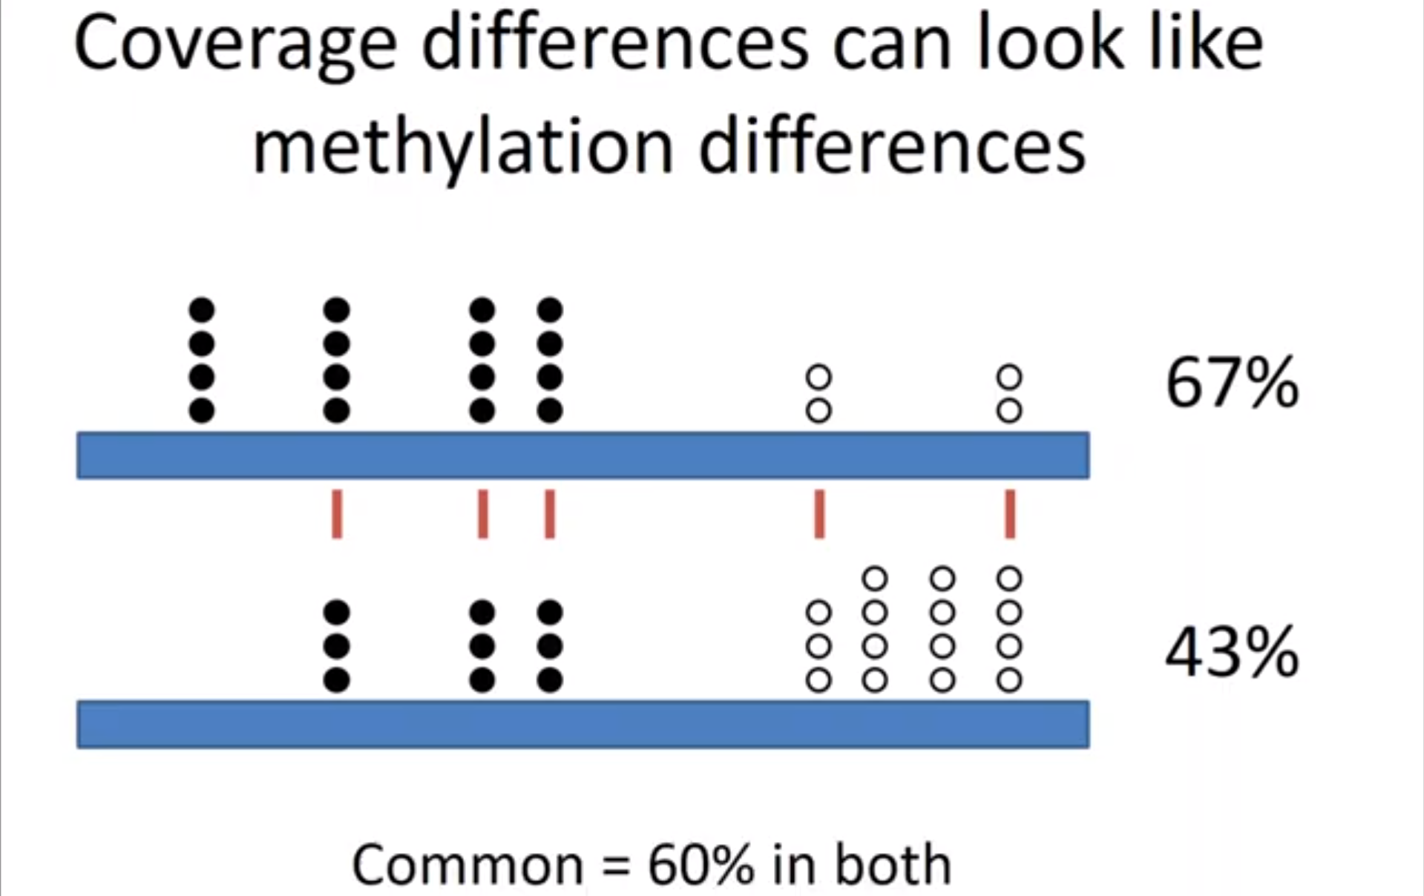
Why do we care?
When looking for differential methylation - you can miss-infer the differences in coverage as they appear as differences in methylation
Coverage diff. ⇏ Methylation diff.
Notes:
Works for small sample comparison
For large comparisons – we predict/compute missing bases to give us more comparable data

Slide 12
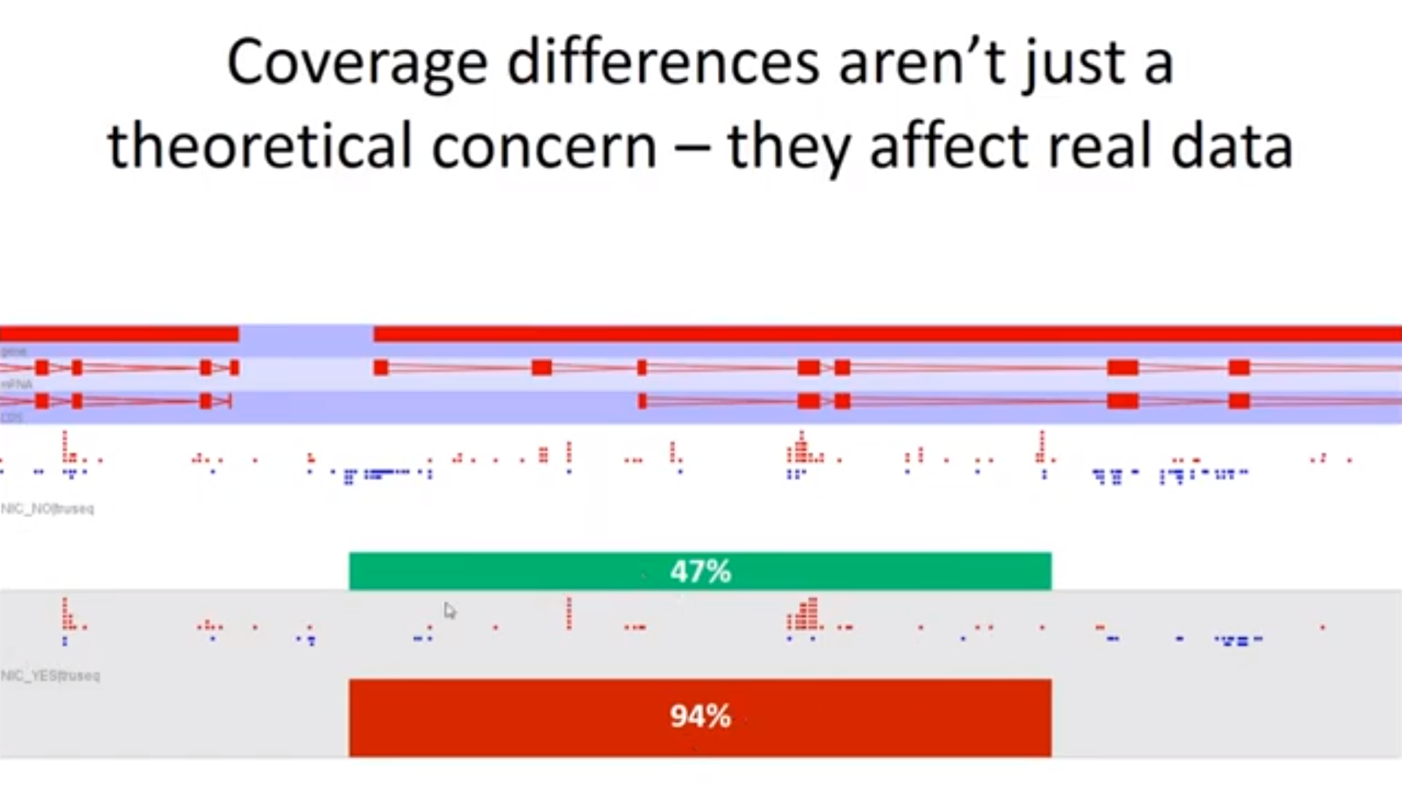
Looking at Methylation Calls
M - Red
UnM - Blue
Changes the whole game
Notes:
Locations of direct comparison -> look exactly the same
Reason for diff. in mean methyl. -> the region of unmethyl. [weren’t measured in the bottom sample]

Slide 13
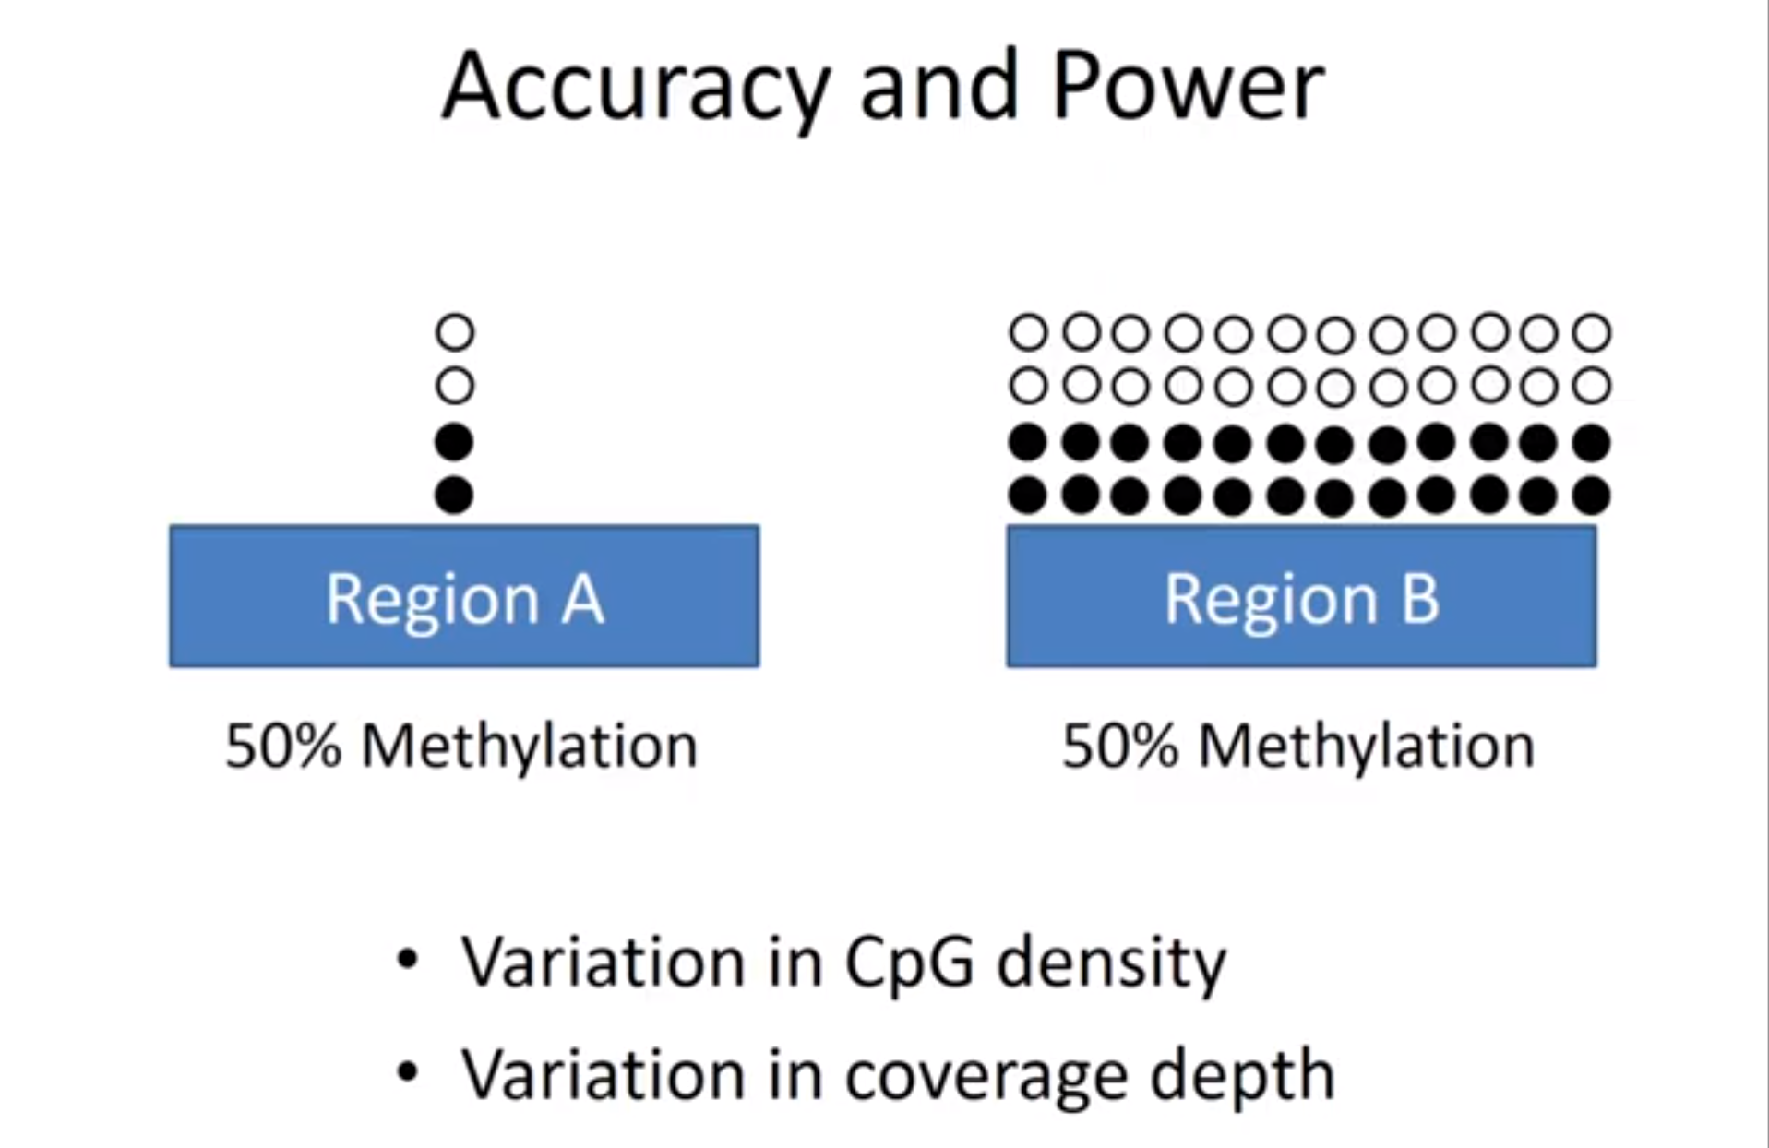

Appear same – but “even” small change in region A can alter %
Small data set, inaccurate
Large, accurate & Stable
Variation causes for same size data set
some kind of enrichment and there was more data over the region A than region B

Slide 14
What does this mean for us?
Avoid bias
Analysis in a way - construct measurement windows that as much as possible have the same amount of data in each window

Slide 15
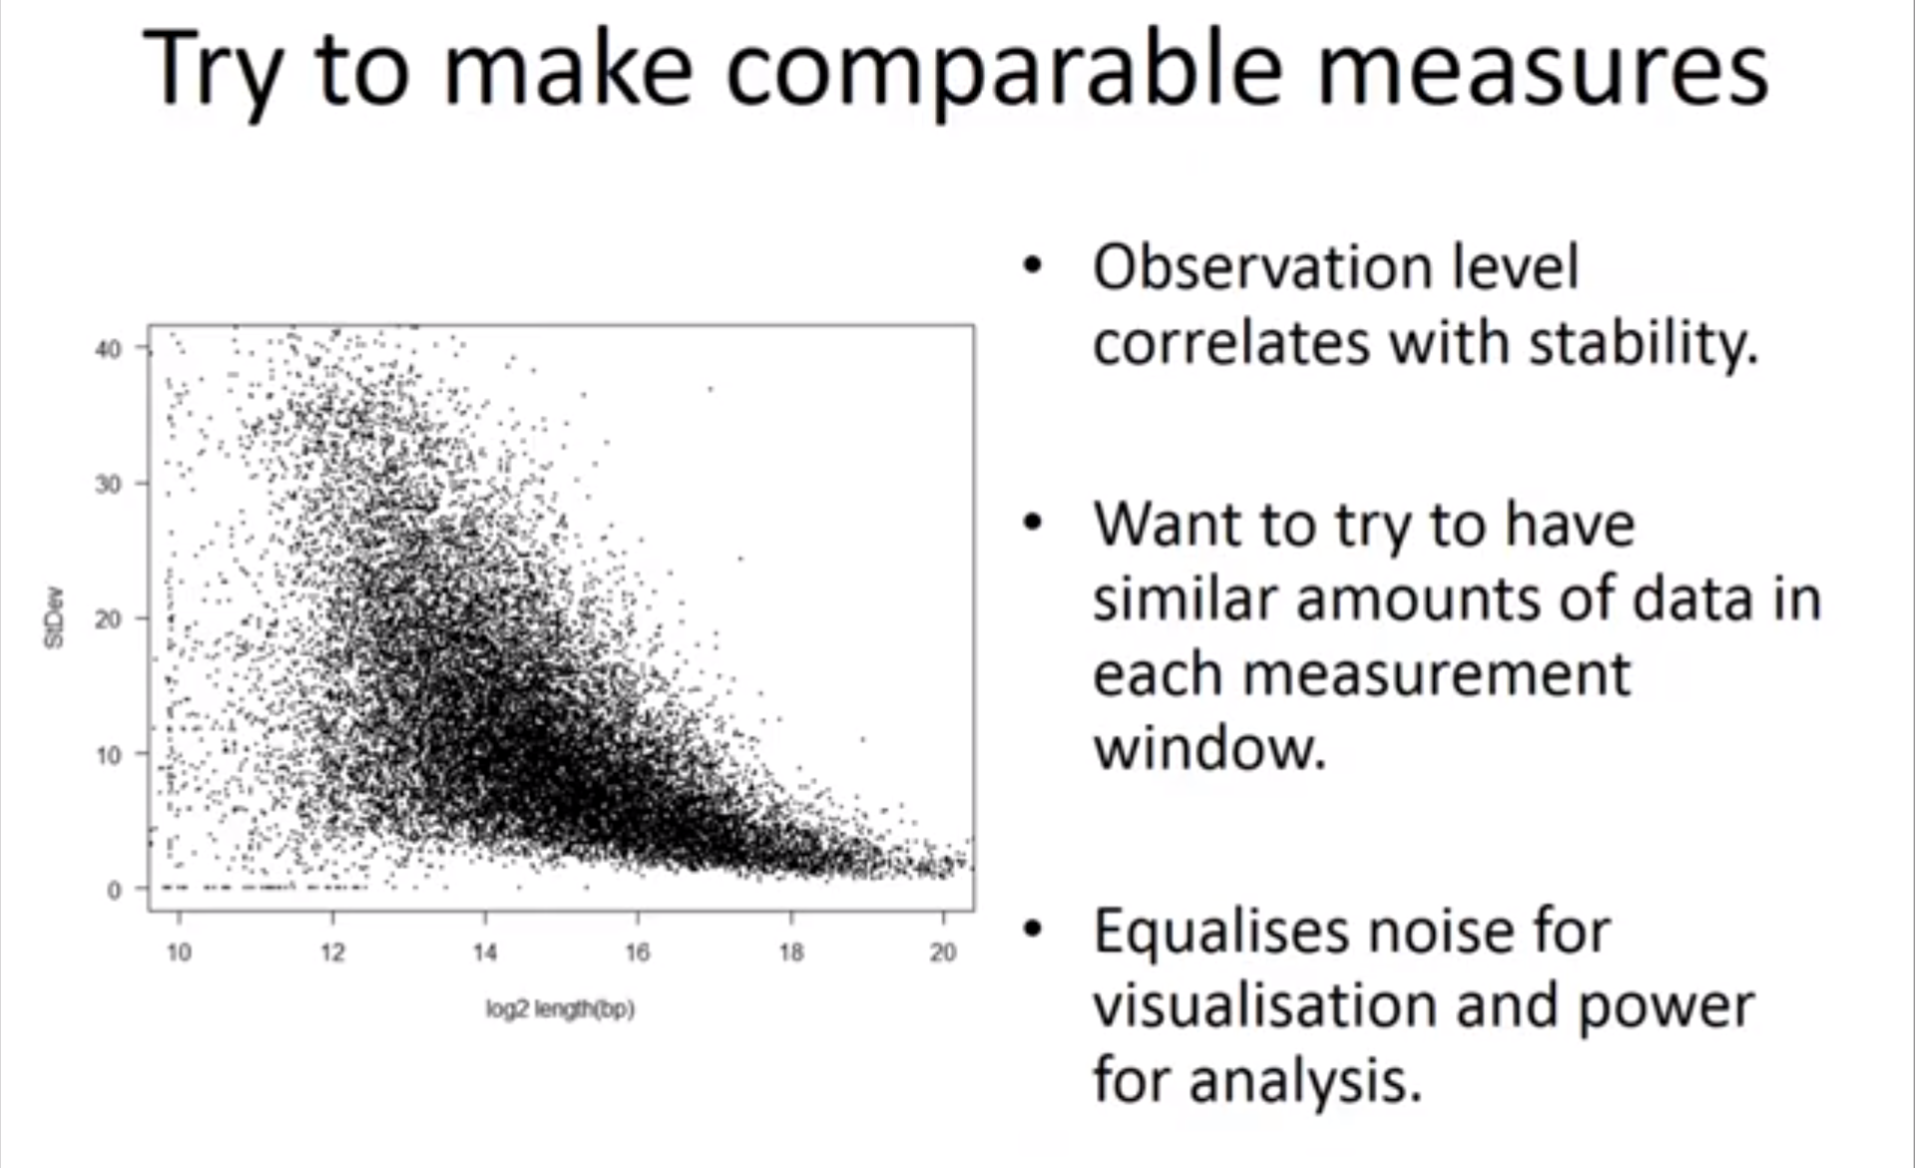
Notice: ↑ Length of region ⇒ ↓ Std. Dev. [a.k.a error]
1 Dot = 1 Gene

Slide 16
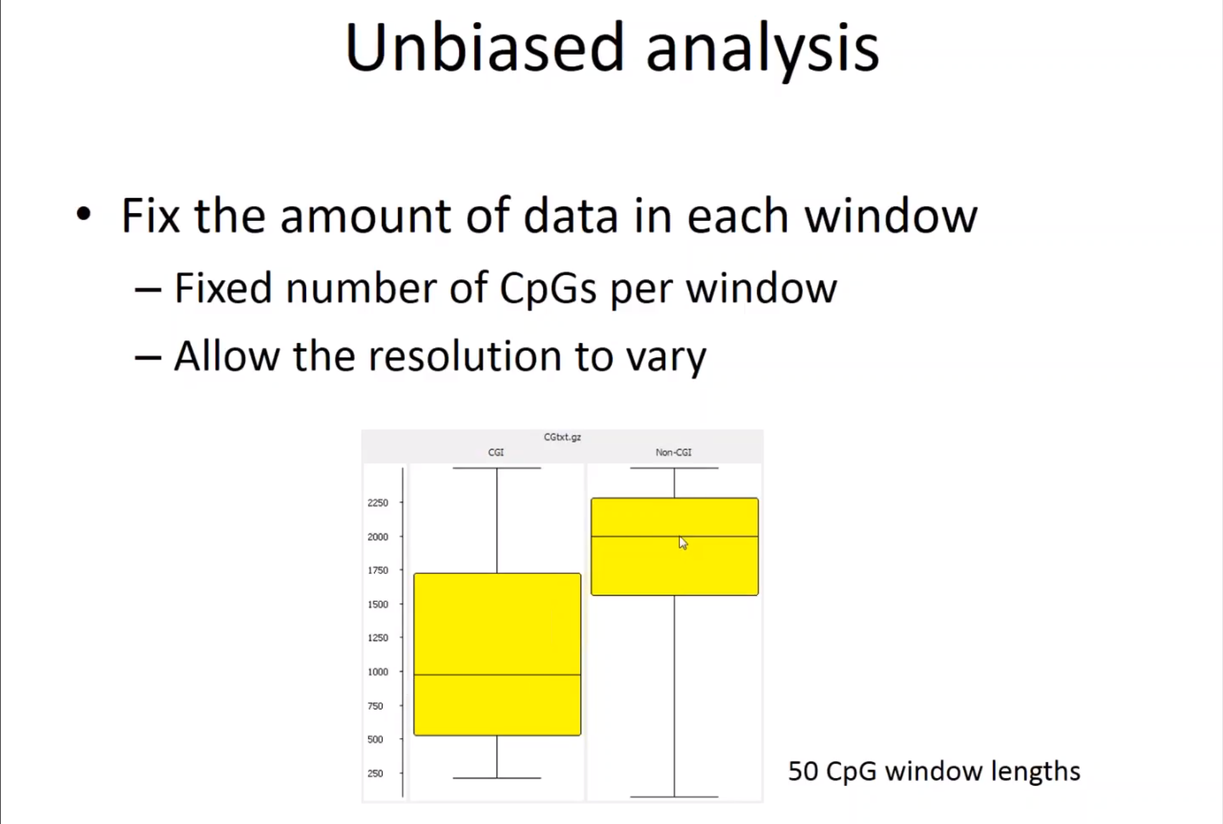

Slide 17
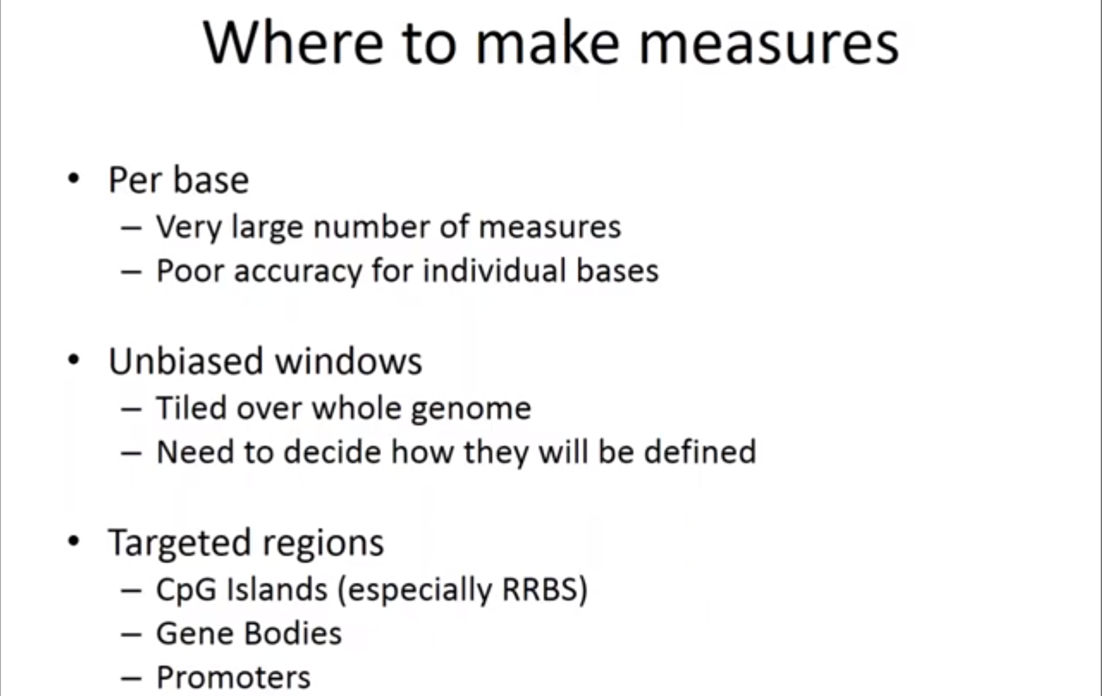
Step 2 - Visualization [SeqMonk]
SeqMonk Functions –
load your coverage files in see all the views
sorts of views quantitate your data
do the statistical comparison
{works end to end}

Slide 18
Why Visualize??
visualize your quantitative values to understand the sort of global pattern of methylation is in your sample and to be able to compare between samples

Slide 19
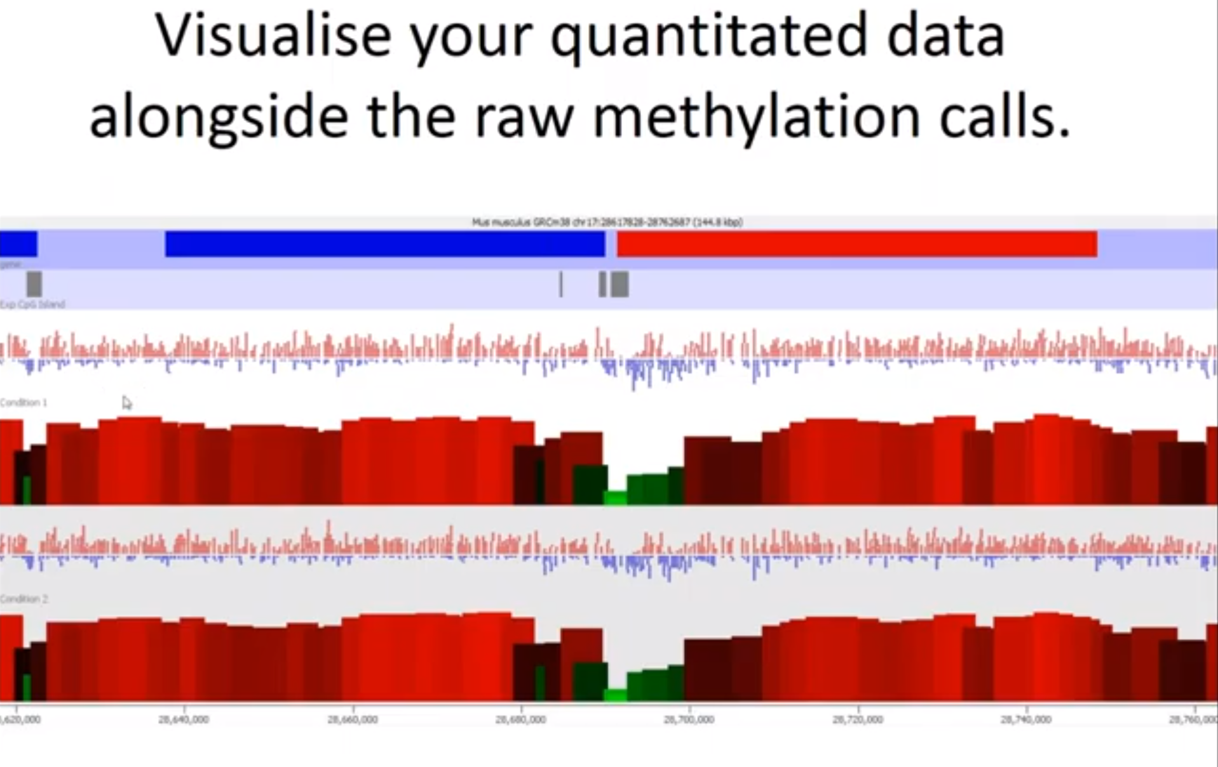
Genomic context Side by side Comparison of Raw data Vs. Quantitative data
General Correspondence should be observed
CpG
Methylation%
Notes:
“here you can see the methylation is quite high and you can see most we were getting red dots but at the pause point where we get to a CpG Island then here we can see the methylation percentage measured drops and then rises over the CpG island”

Slide 20
Step 3 - summarizing methylation
Look Globally before Individually
“if the sample as a whole is changing that's the big biological picture and actually it's not so much what's happening at an indv. level that matters”

Slide 21
The distribution of methylation levels across your genome
Better representation than Mean Methylation across the whole genome
Tends to be Bimodally distributed
Large number of parts of the genome which are completely unmethylated and another large portion which are completely methylated and actually very little in between
Example - When comparing you're summarizing your samples if the mean methylation level for this sample – is about 60% or so
But 60% is a value that almost nothing in the genome has and you've got a
Lot of stuff that's 80 or 90% and a lot of stuff that's 20% or below

Slide 22
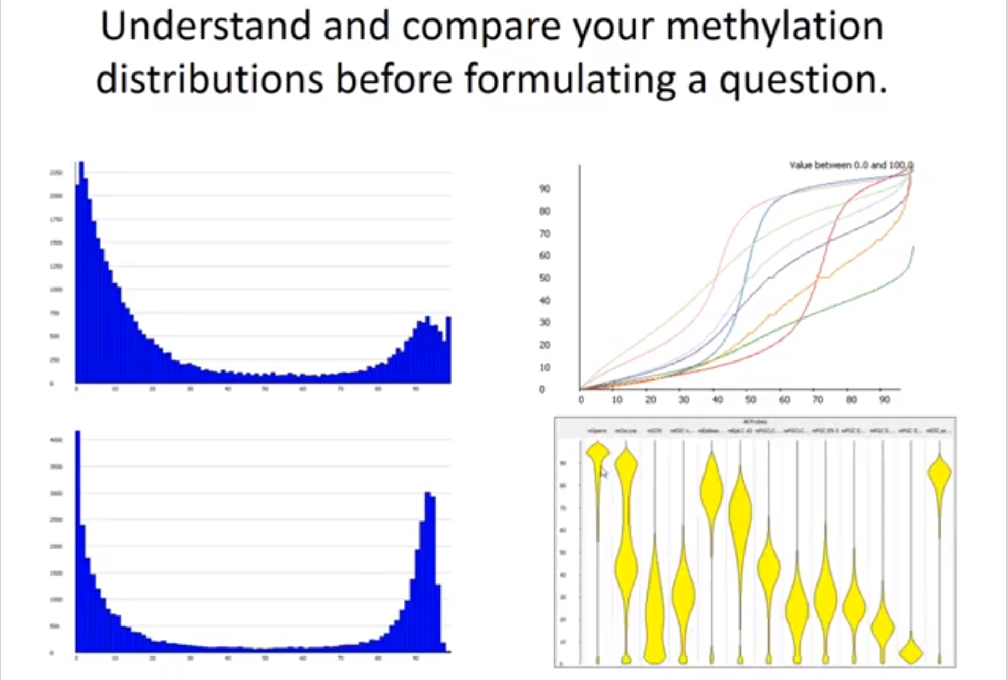
Look at this early on
y axis -methylation% against the percentile
through the data
The Dist. –
What is the dist.?
Does it change between sample?
Bean plots - 👍
Fundamental diff.s in the happening
of methylation
a set of positions that do a staged change from low to high – never in between
Notes:
“the shape of the distribution is about the same but that the proportion of regions that fall into the high and low methylated blocks shifts so in this bottom one there's more data in the high region and less in the low region”

Slide 23
Possible problems
Globally obvs. Problems should be apparent
How should we search for these -
Firstly randomly browse the genome
Secondly you should look at anywhere where you think you know what should be happening
For example – Looking at a methylation sample; look through particular regions which we know are supposed to be differentially methylated
Why? - ∵ that should either match with your expectations or if it doesn't then you've got something you need to understand

Slide 24
Before INDV. Regional analysis [DIFF. Anal.]

Slide 25
Part II – Differential Methylation Analysis
Where should we use this? - looking for are methylation changes in response to something that you've done’
This is Where I come in…
Notes:
you need to understand it
so you need to be able to visualize it
you need to be able to look
both raw data and make sensible
decisions about how to quantitate that
and then from the quantitation x' you
can then start looking for global
differences or indeed sort of start
looking at individual regions of the
genome to try and understand that in
more depth

Slide 26
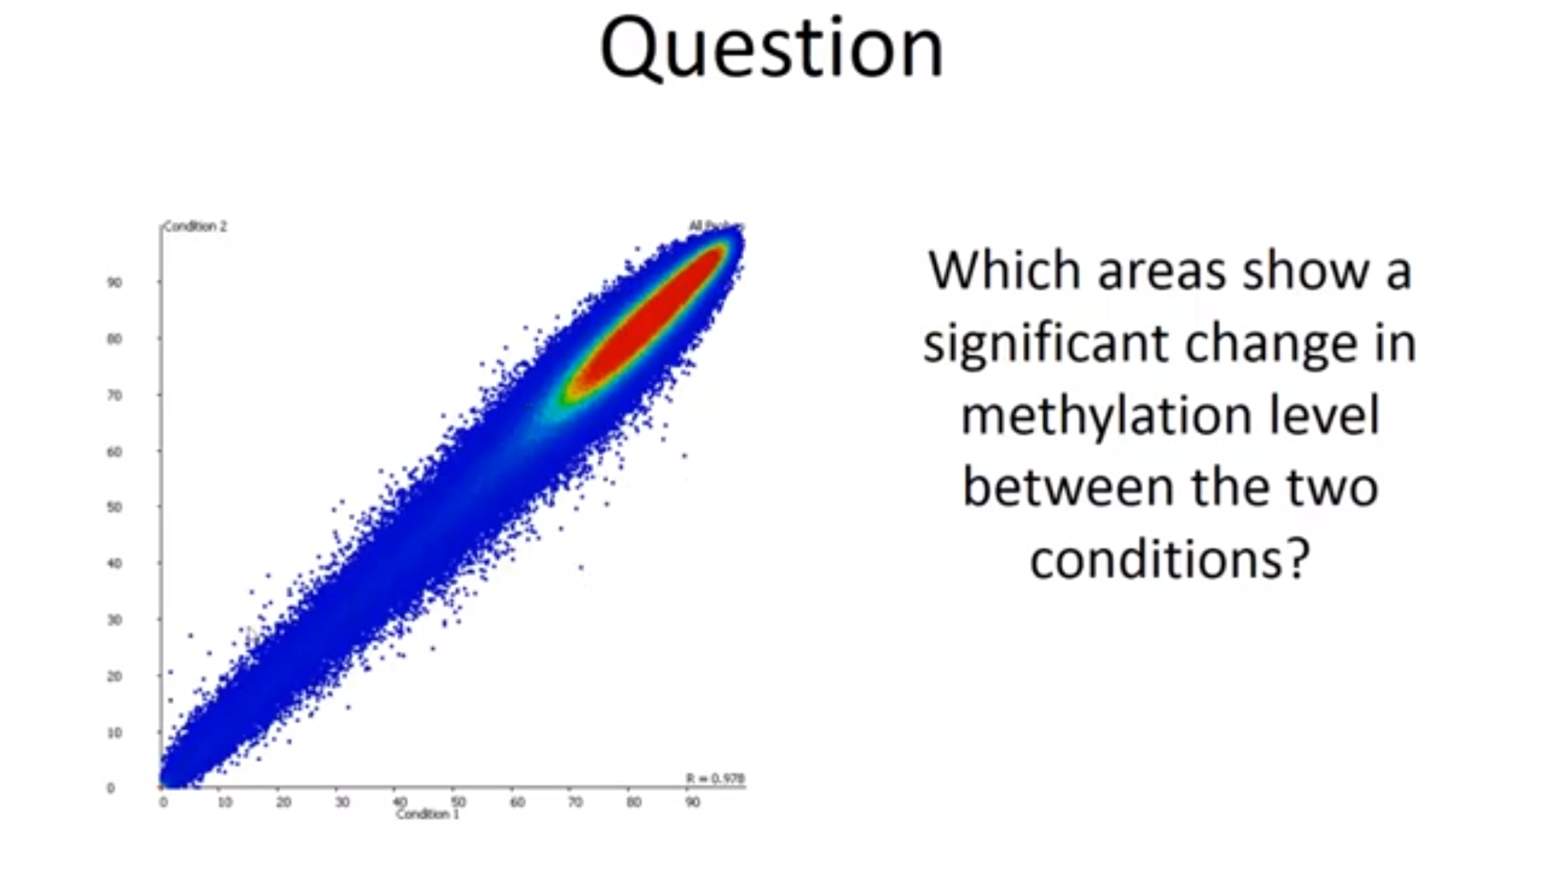
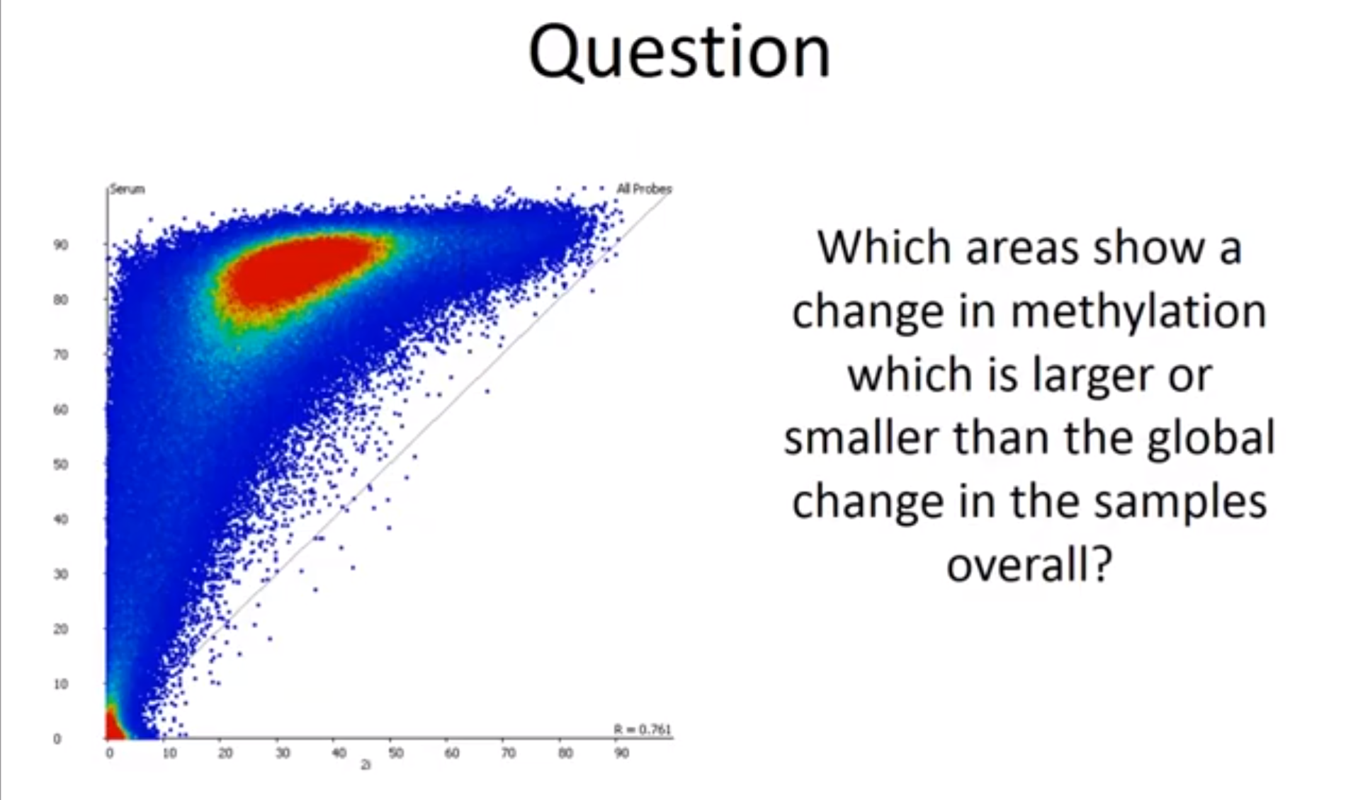
What Question To ask…
Natural 1st Q – Whats Diff.?
Sensible – little dev. from x=y
Not-Sensible – everything is diff.
Possible points of interest
Interesting - Why didn’t it change as much?
POI – Variation form general trend

Slide 27
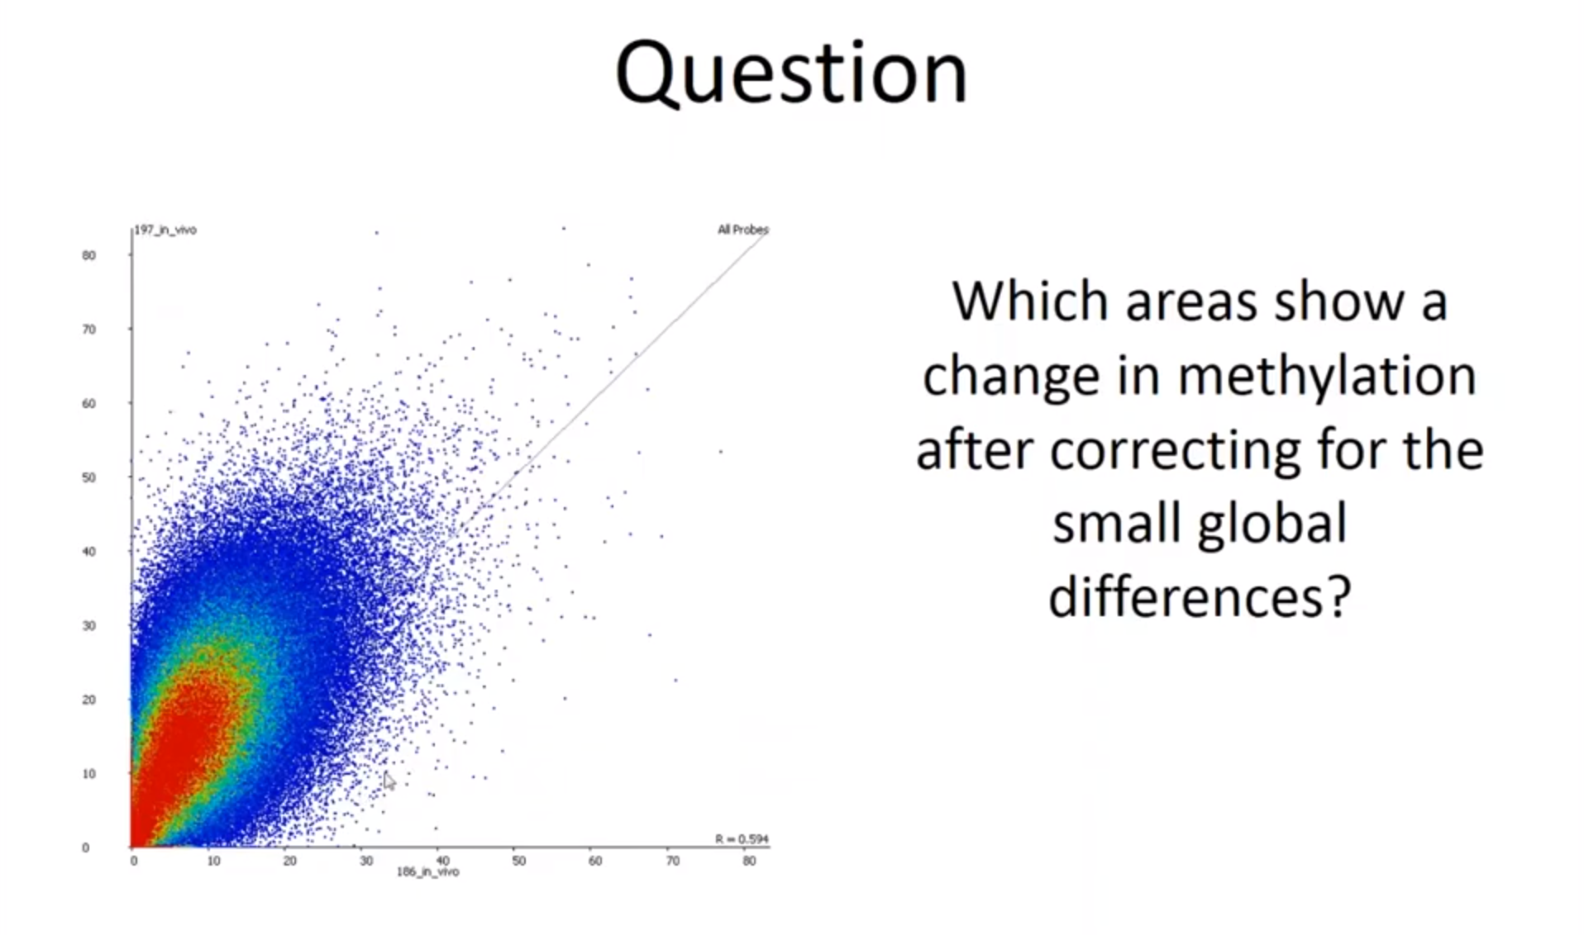
Hybrid Methylation Comparison
Notice: Global shift.
Sensible approach – 1st Account for shift – Method?
2nd Search for unusually changing point

Slide 28
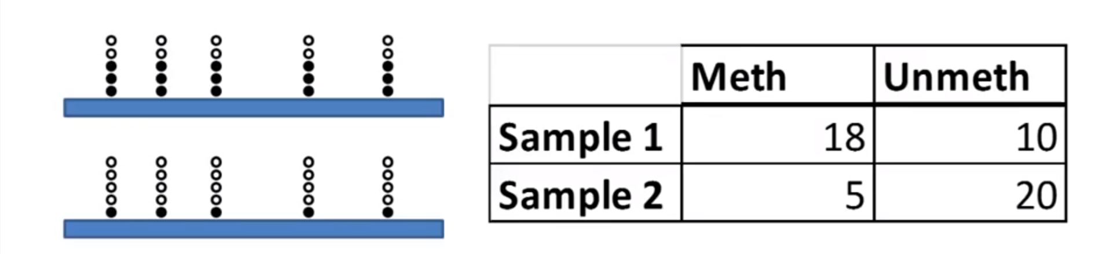
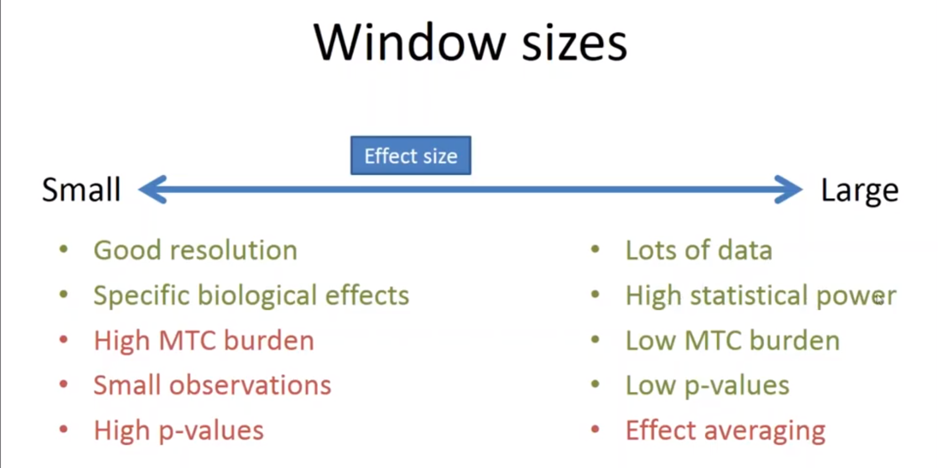
Count-Based Statistics (Pair-wise Comparison)
Statistically diff. – 1. No. of obsv.
2. Methyl ratio
↑ Stat power ⇒ ↑ Conf. in C-B Stats
Run into a problem
Can’t analyse every C in genome
Can’t analyse every C in genome
Use windows
Leads to… Trade off
Notes:
Stat. significance – p-value
Mtc – Testing correction
Effective avg. – When window > Region of diff. methyl. ⇒More data but… Avg. away the effect of..
Before analysis – Pre-computed power analysis (good) - realistically likely to be able to see the sort of data that you want to see

Slide 29
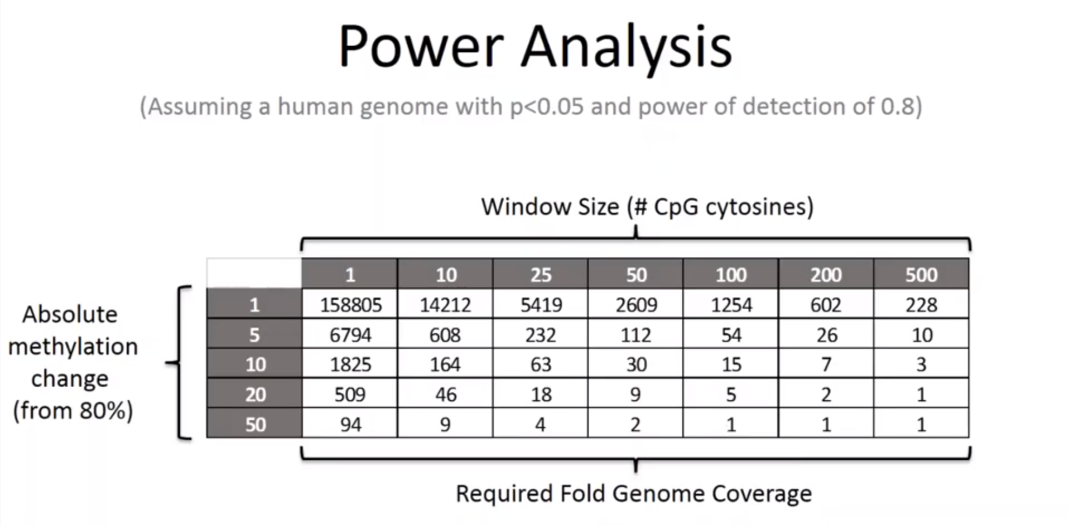
???

Slide 30
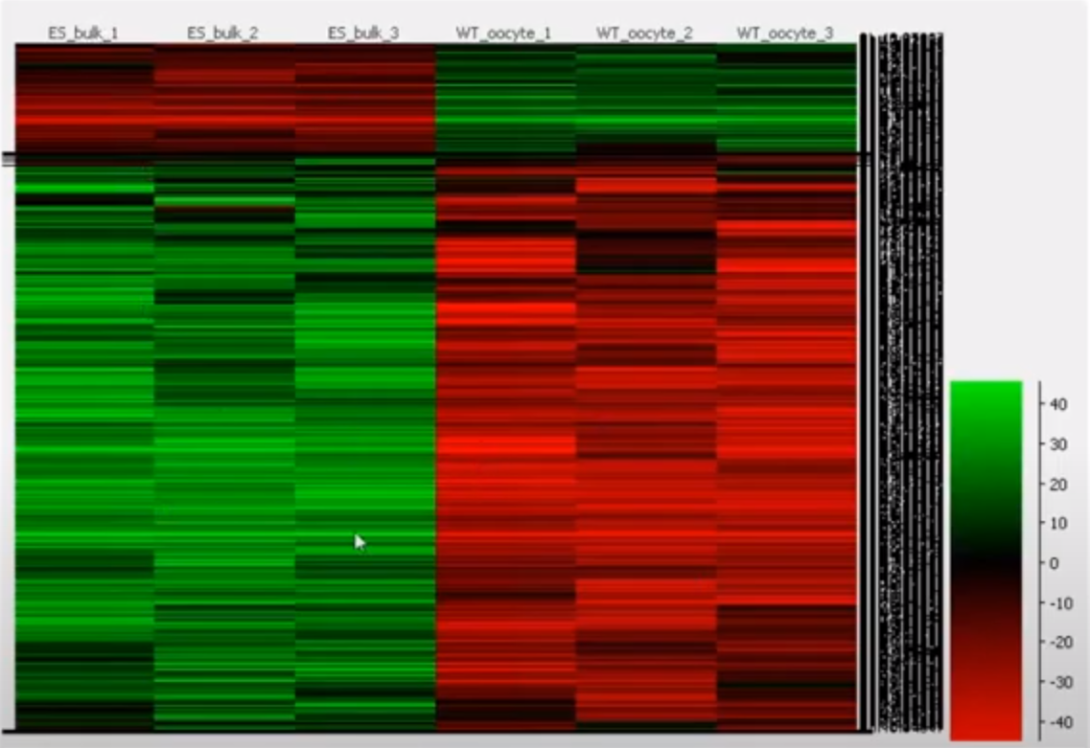
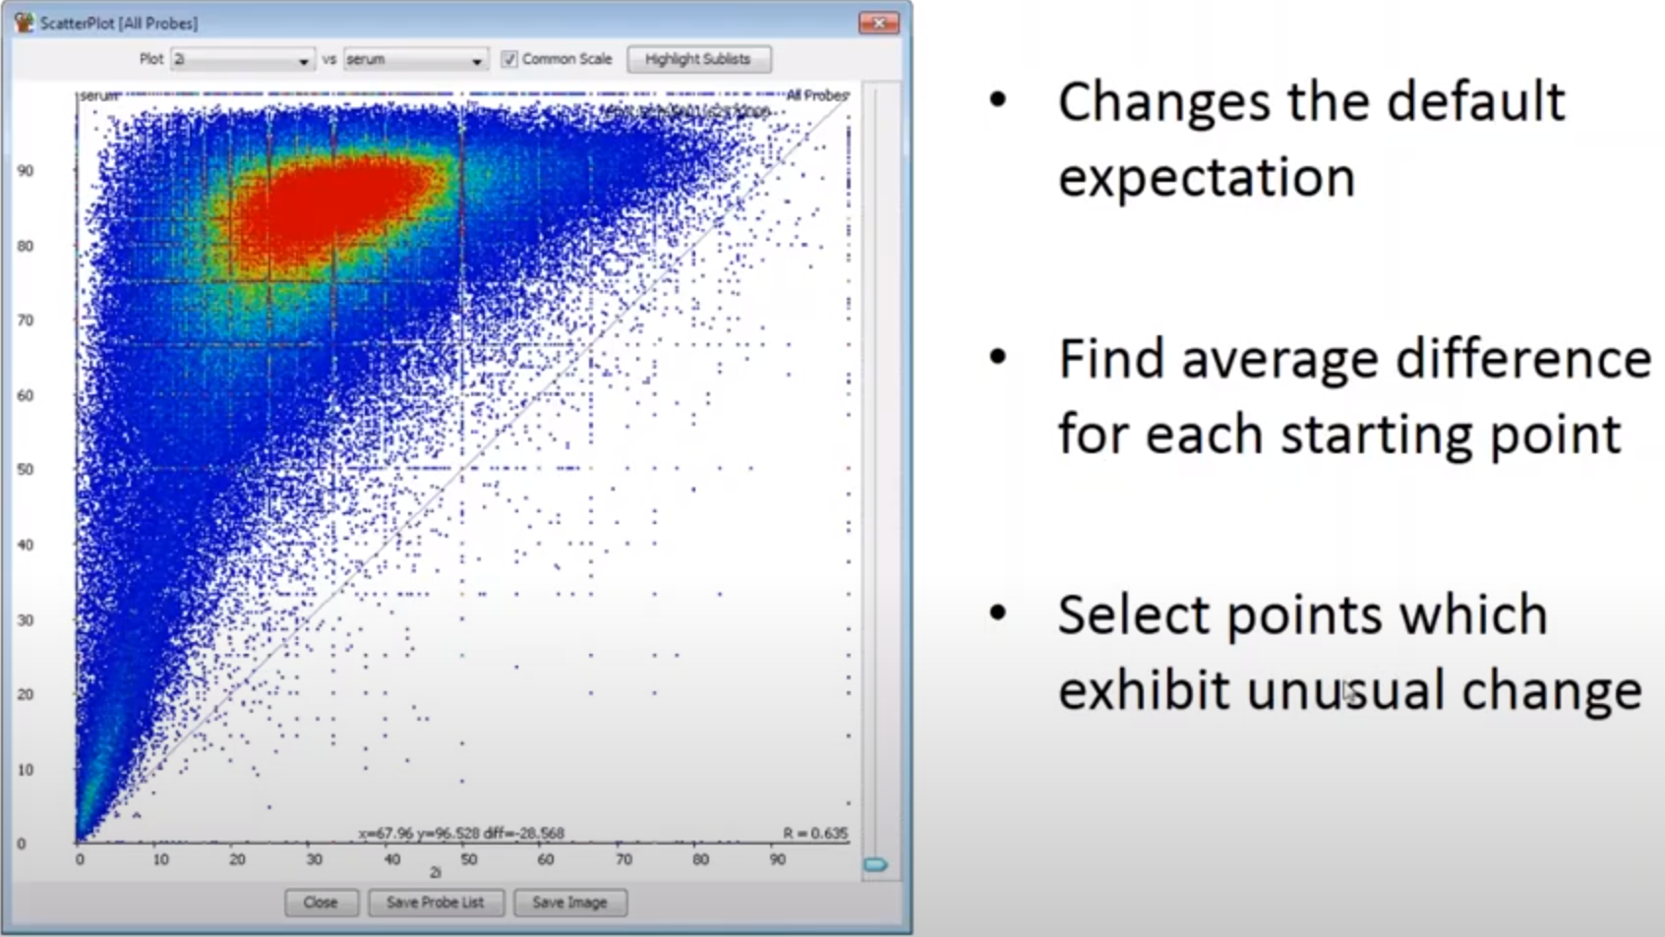
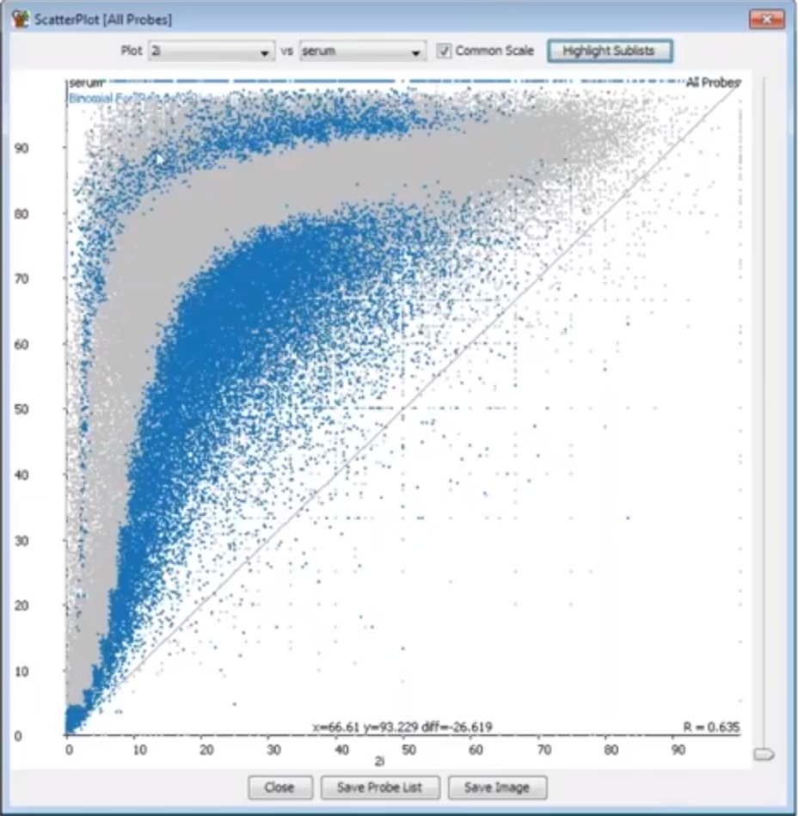
Applicable Statistics
Unreplicated – Limitation: single observation statistics
Chi-squred
Fisher exact
Replicated – Recommended
1. Logistic Regression (well behaved) 2. Globally shifted data
Convergence - 20 observ. per bin
Lost more Or Retained more

Slide 31
